Slide 1
Take Hemp, Inc Marc Jacobson Rahway, New Jersey
Marc@TakeHemp.com (732)215-2585
www.TakeHemp.com

Slide 2
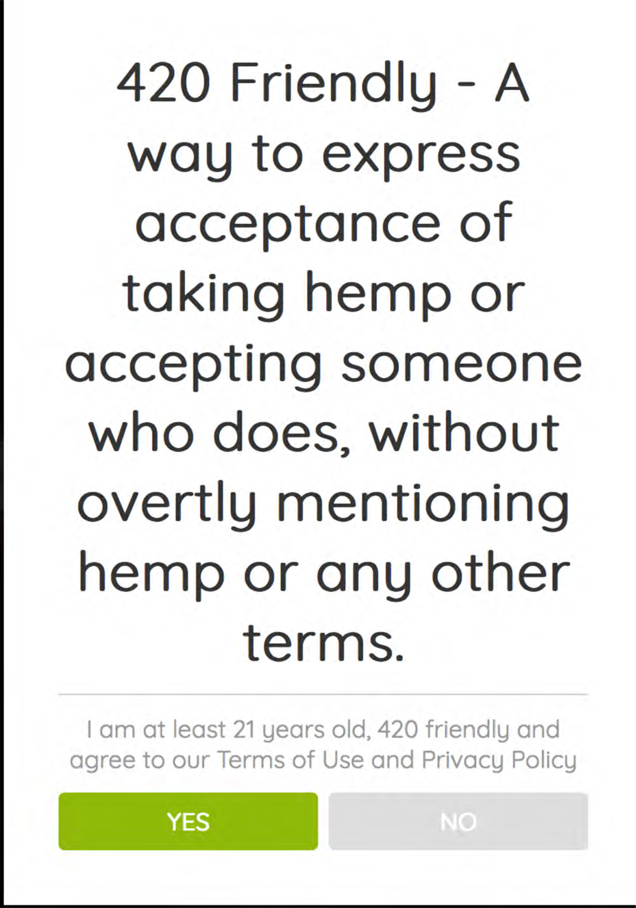

Slide 3
PROBLEM
Challenges of Hemp & CBD Businesses
CC
Processing Issues
Limited Advertising
Conflicting Laws
Negative Perception
Regulations Changing

Slide 4
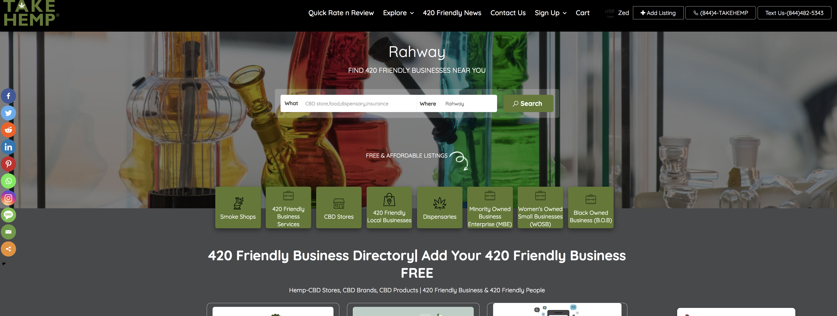
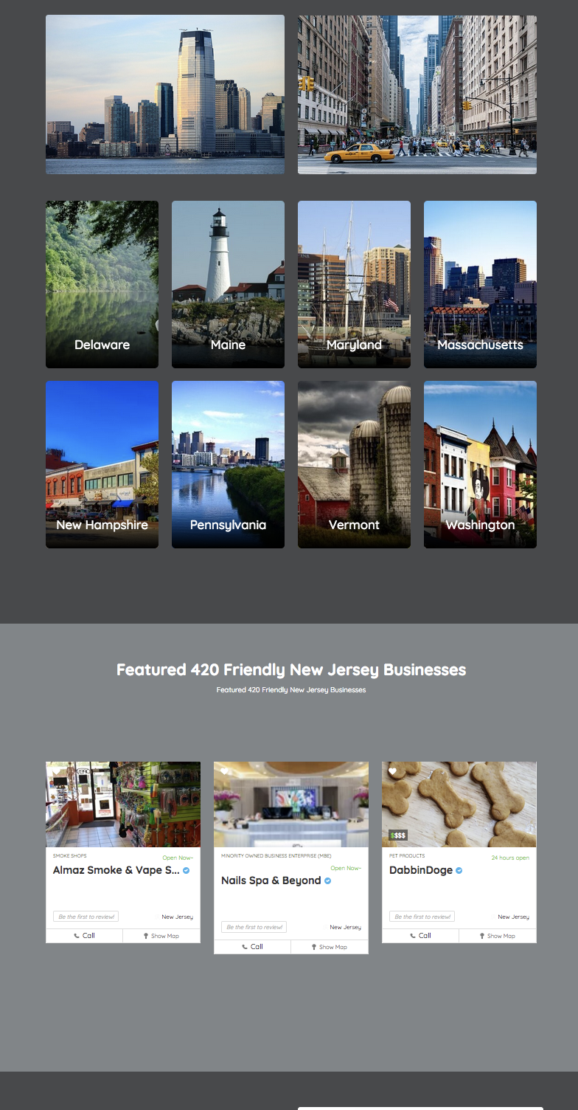
Solution- More Than A Business Directory
TaT
.
What if Yellowpages /Yelp had a baby with Leafly or Weedmaps? -
TakeHemp.com
Take Hemp will be the largest curated database of active 420 Friendly Businesses in New Jersey & New York before it scales into the additional recreational markets of the Northeast

Slide 5
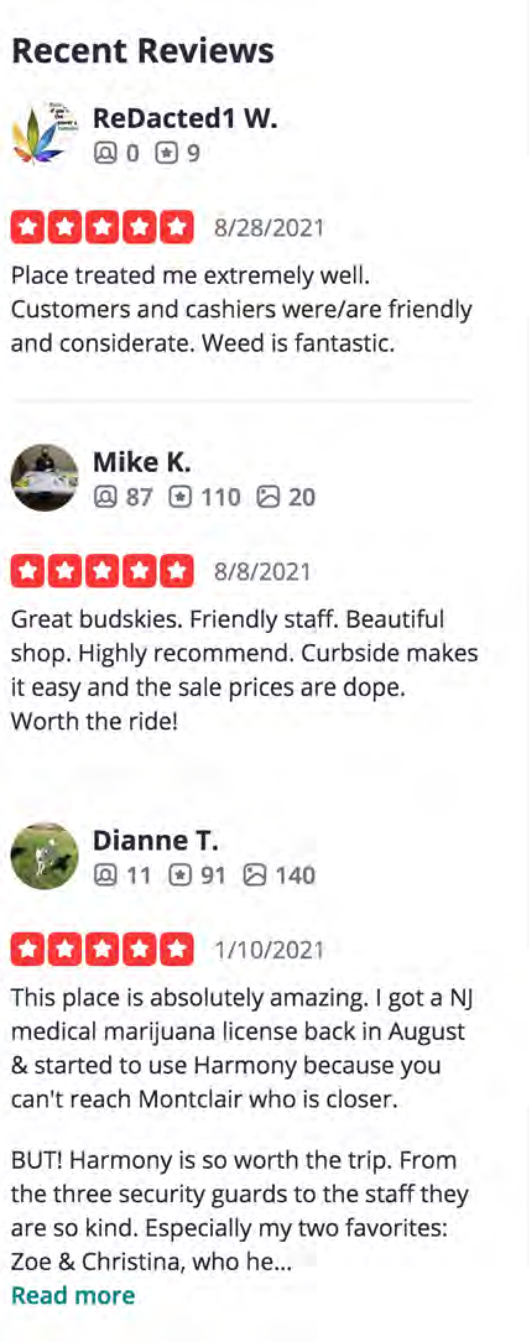
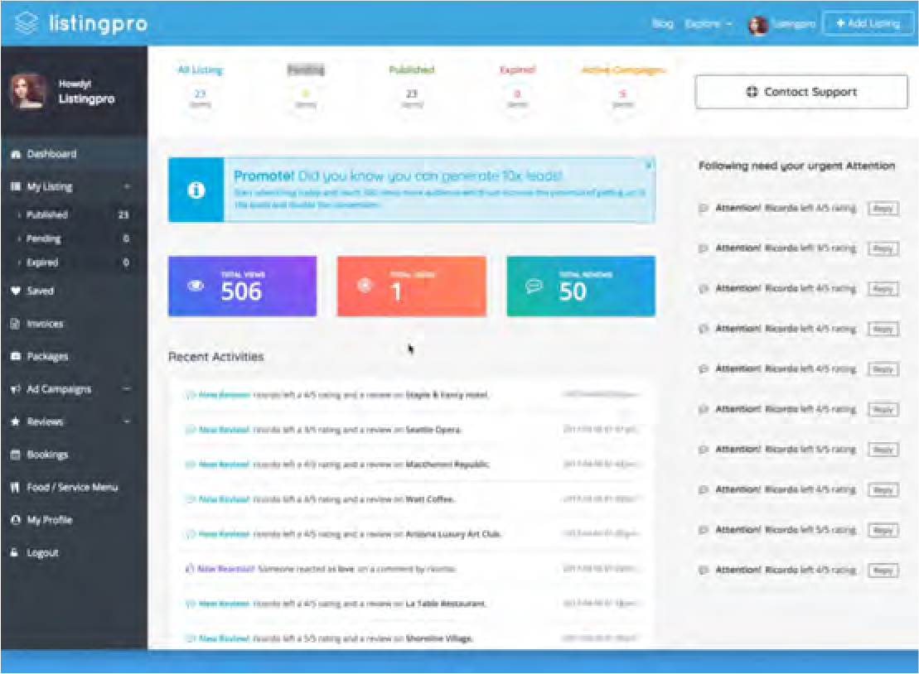
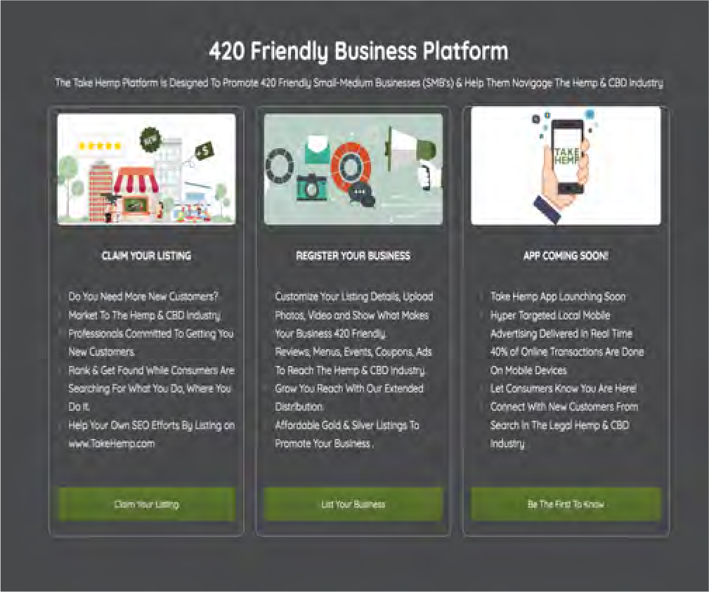
Solution- A Tech Company Offering
Business Directory Value
Hyper local businesses search & low cost, ready to buy targeted leads.
Powerful Data Analytics
User dashboard provides business critical KPI’s.
Build Trust & Confidence
Become a leading destination for Hemp & CBD Industry.
Business Reviews
Use reviews to become a leading destination for Hemp & CBD Industry.
Awesome Customer Experience
24x7 Live Support and a company dedicated to promoting your businessy.

Slide 6
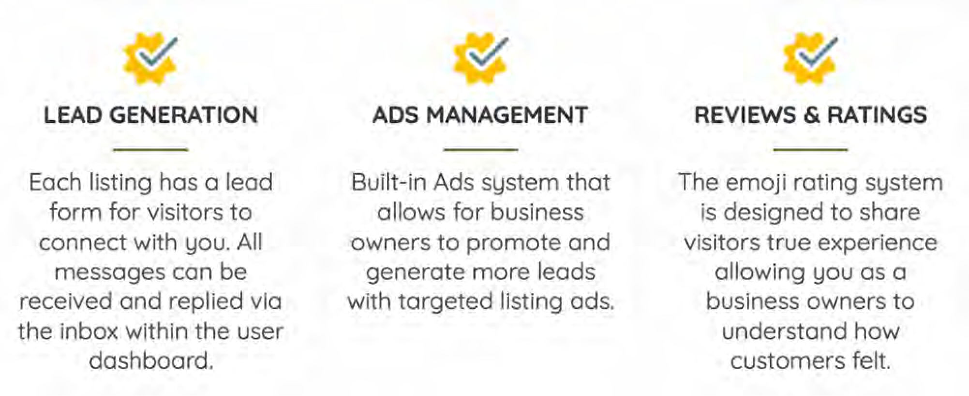
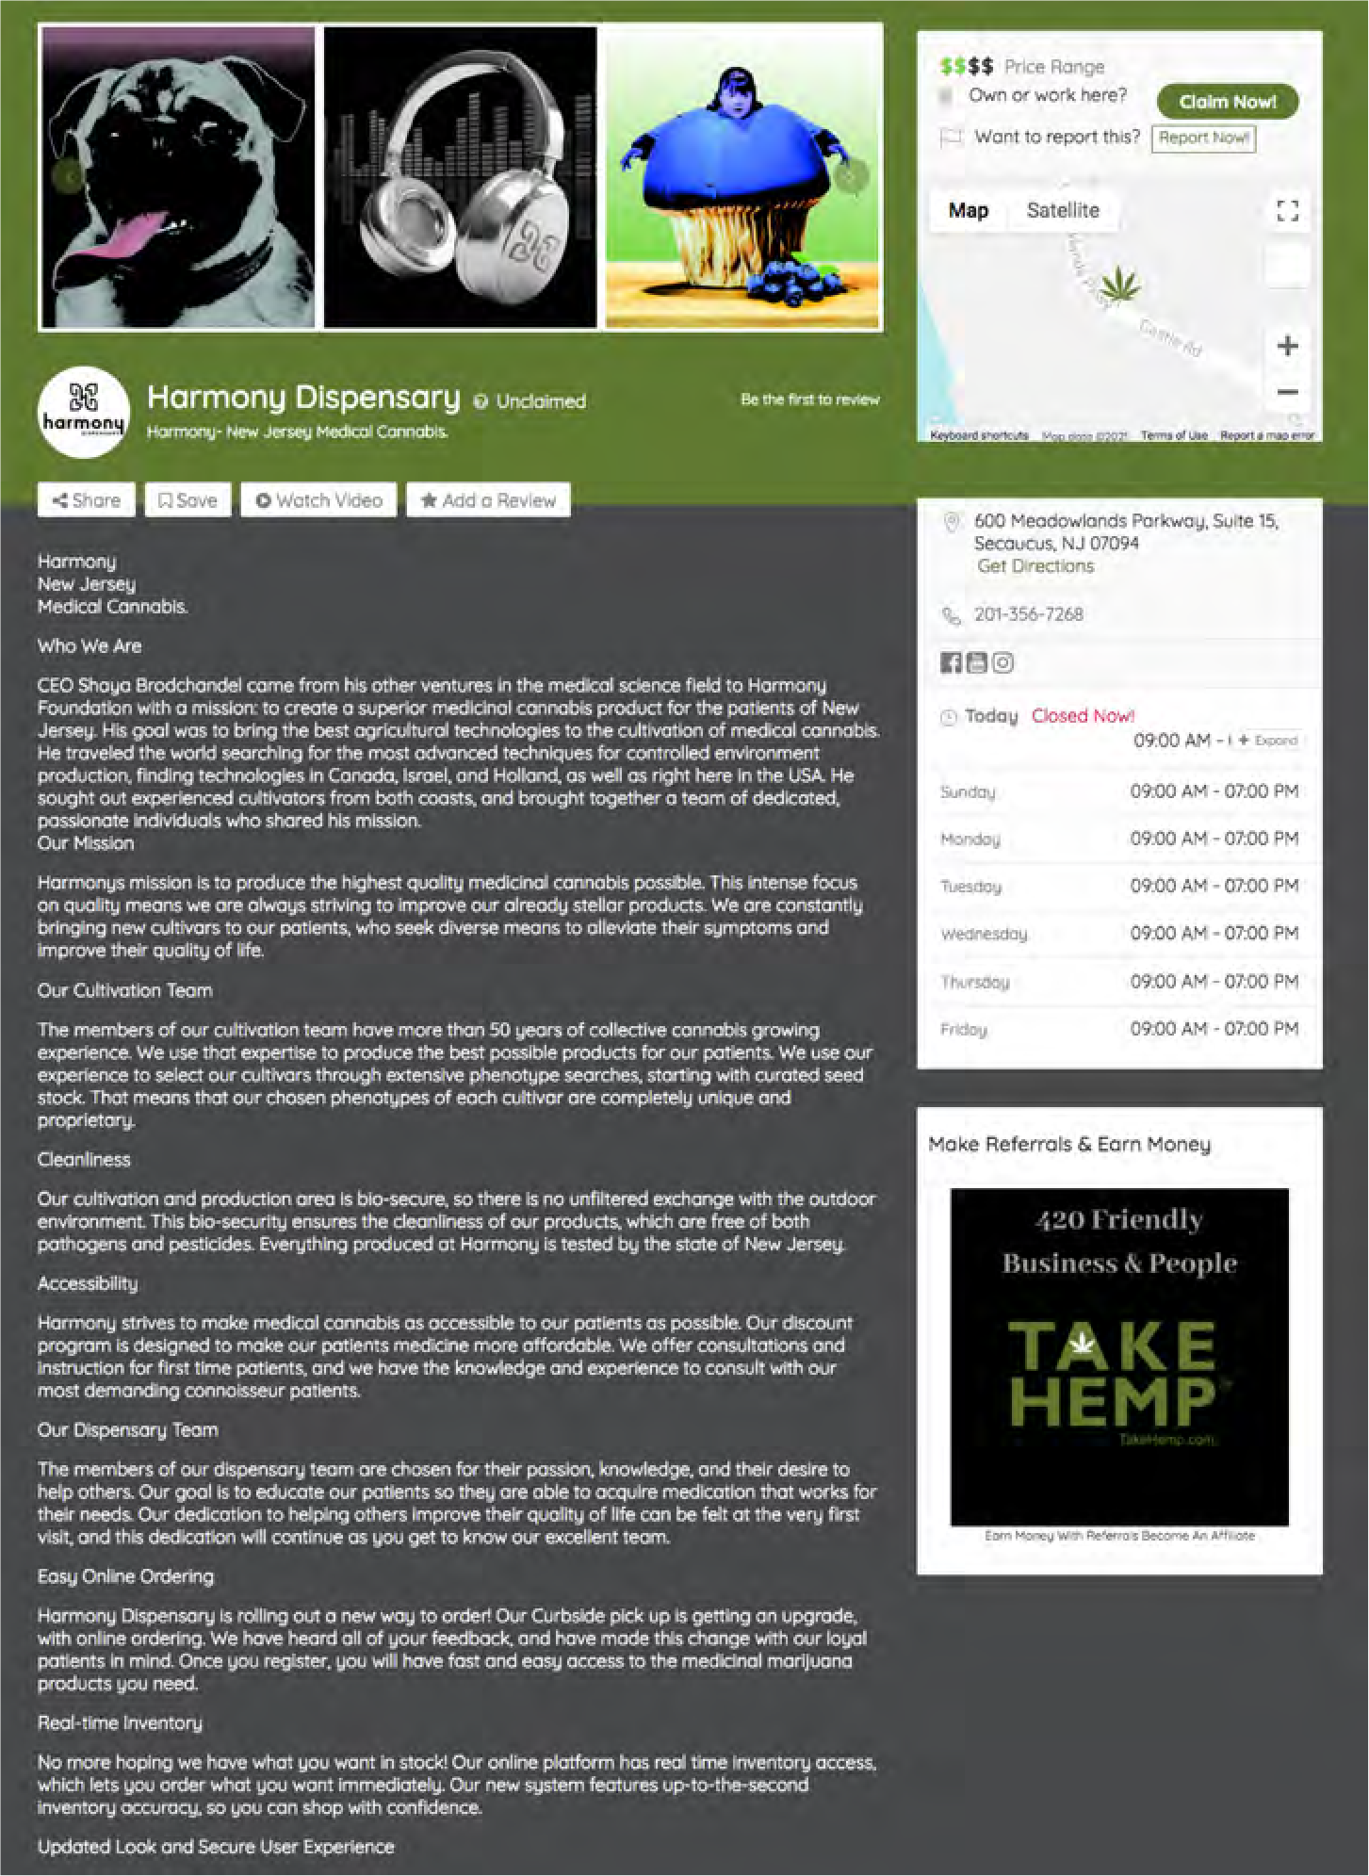
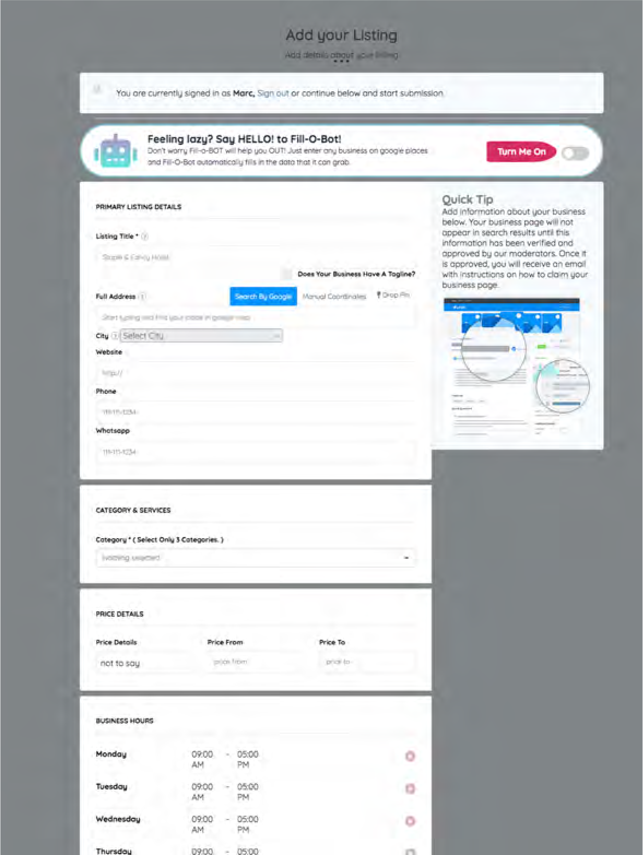
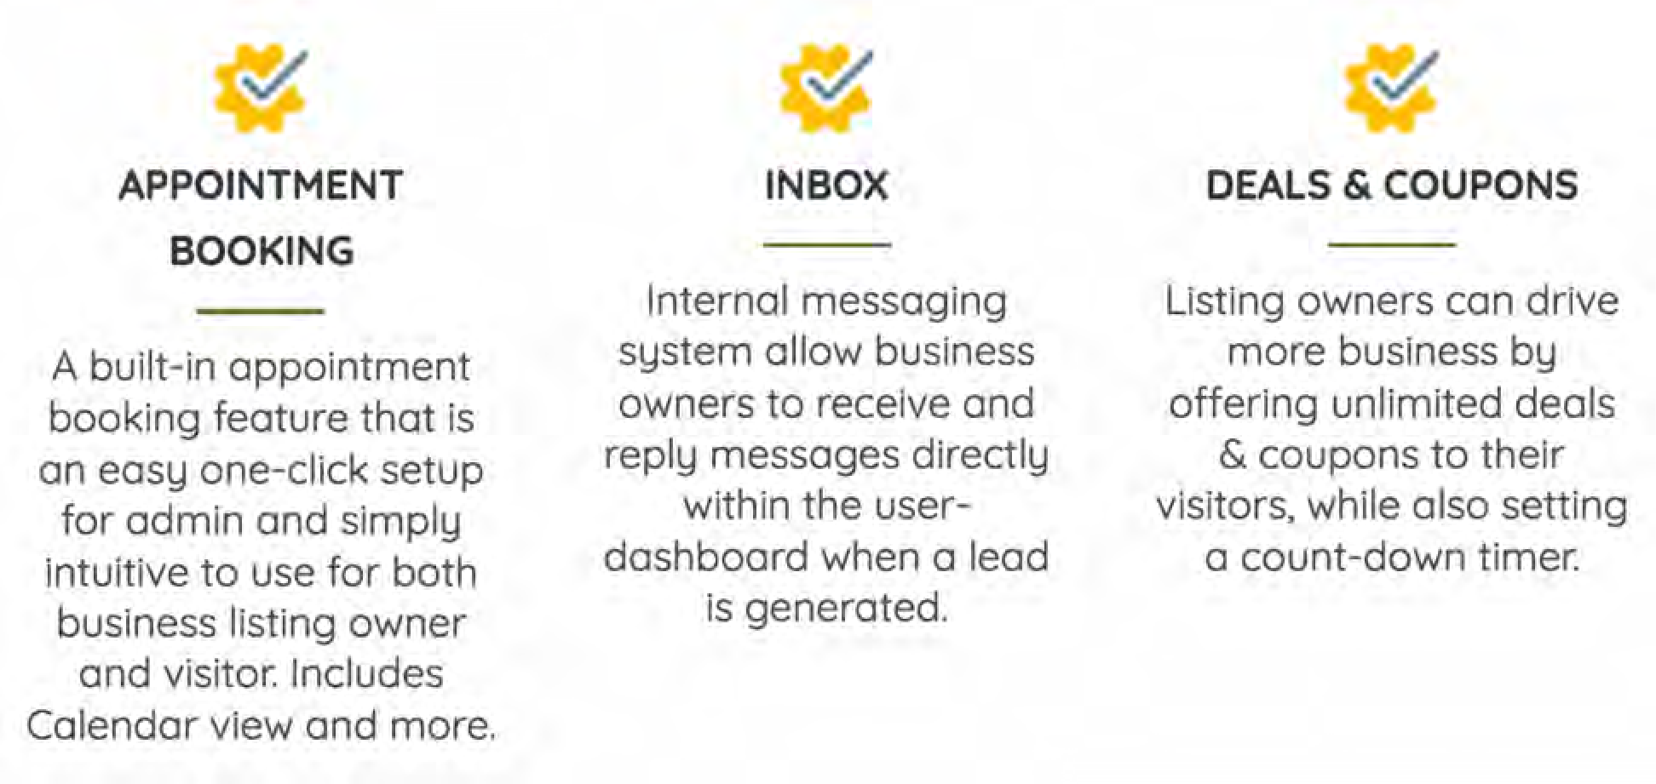
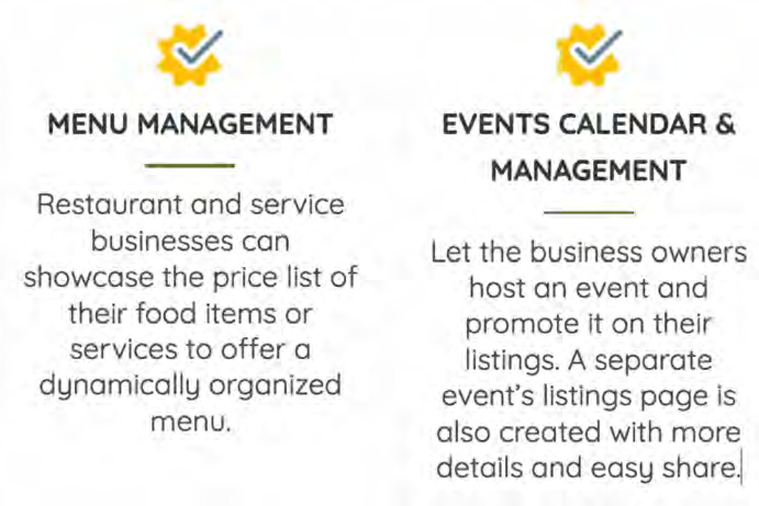
Product 1.0

Slide 7
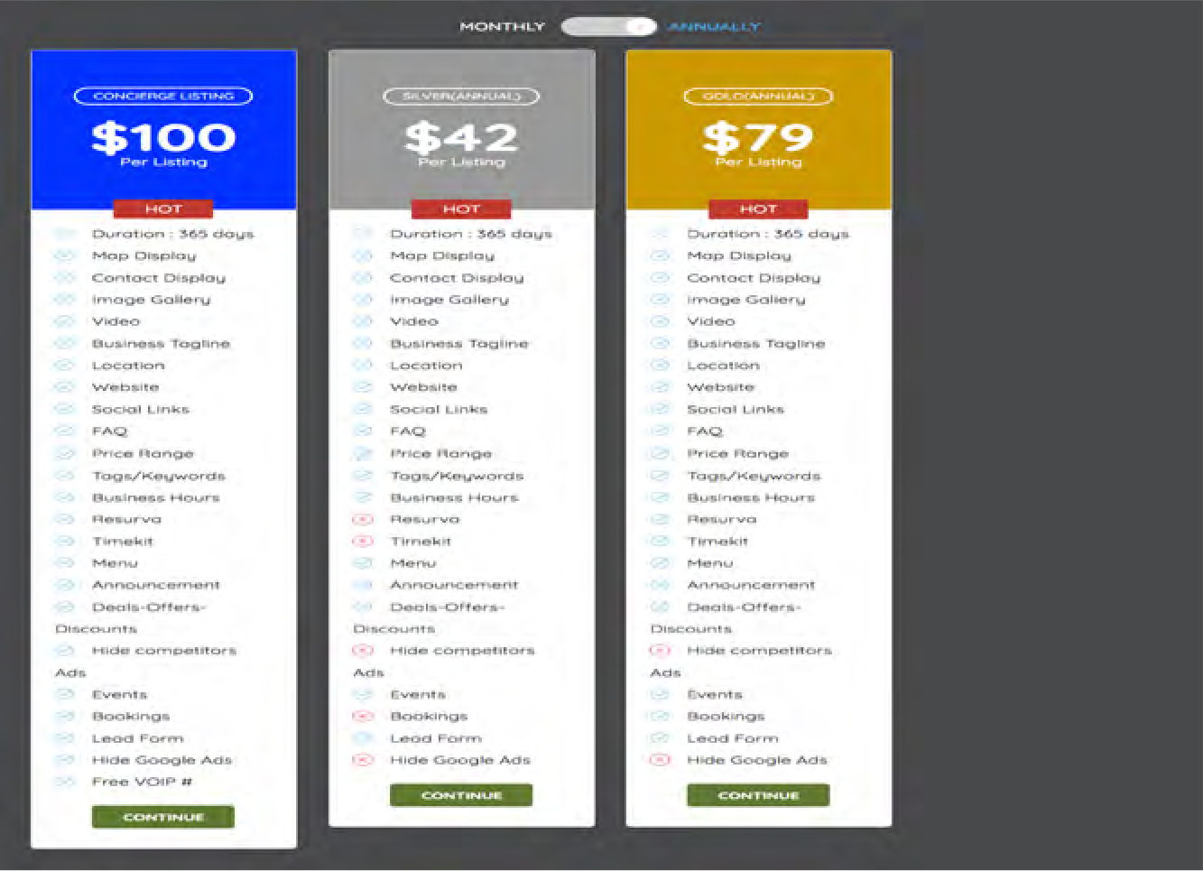
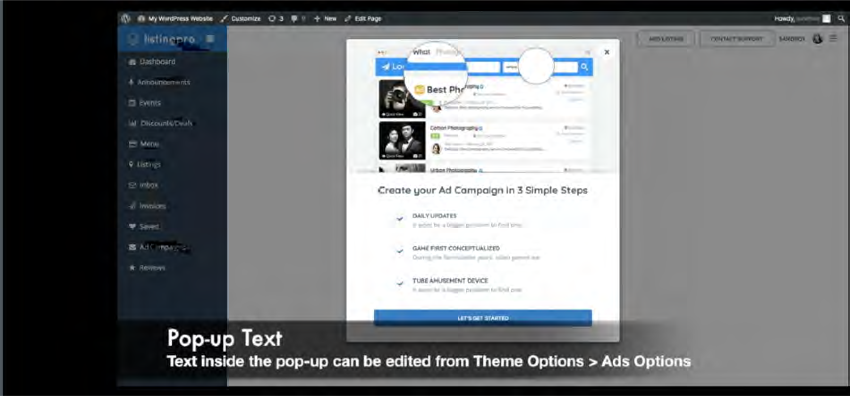
Revenue Model
SaaS Subscription Monthly/ Annual
State, Regional & National Affordable Advertising
Video Ads
Built in Ad system with listing ads displayed throughout site
Spotlight Ad, Top of Search Ads, Sidebar Ads
Generate more leads with targeted ads
Take Hemp Affiliate Army
Commissioned salesr Recruits and trainers

Slide 8
Sales Strategy
ONGOING Features
Black Owned Business
Minority Owned Business
Women’s Owned Business
LGBT+Q Owned Business
Disabled Owned Business
Veterans Owned Business
Sales Funnel Automation
Face To Face Territory Development
Efficient Online Marketing
Advertiser Generated Content FREE
SEO AI Content Generation
#420Friendly
#420FriendlyBusiness
#420FriendlyDirectory
#420FriendlyBusinssDirectory
In Person Visits Geo Targeted
Marc Jacobson-President & Director of Sales
New Jersey
Digital Billboards
Email Marketing
& Automation
Press Releases
SEO
MARKETING
Burt Kraus- Regional Director
Brooklyn -Journee
Queens
Nassau County
Suffolk County
Affiliates
Website Content
Analytics & Reporting
Social Mediia
Paid Advertising

Slide 9
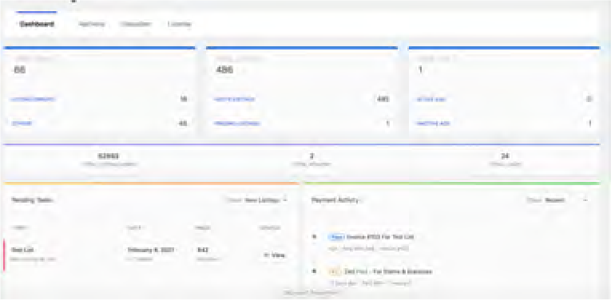
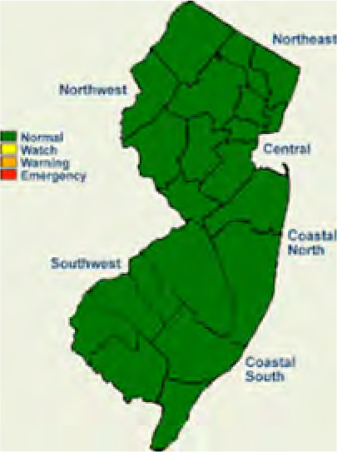
Take Hemp Timeline
Hemp & CBD
The 2018 Farm Bill made CBD products legal
Development
2019-2021
New Jersey Legalized adult use Cannabis 02/22/2021
CBD is legal in all 50 states, however the law is different from state to state.
NJ Sales Launch
Cannabis
Legislatures in four states made cannabis legal in 2021
Rec-Colorado, Washington, Alaska, Oregon, District of Columbia, California, Maine, Massachusetts, Nevada, Michigan, Vermont, Illinois, Arizona, Montana, New Jersey, and South Dakota.
2021 4th Quarter
Targeting 90 Municipalities signed on to adult use
Angel / Seed/ VD or Reg CF Crowdfunding
2022 2nd Quarter
Approved for up to $5 Million in 12 months

Slide 10
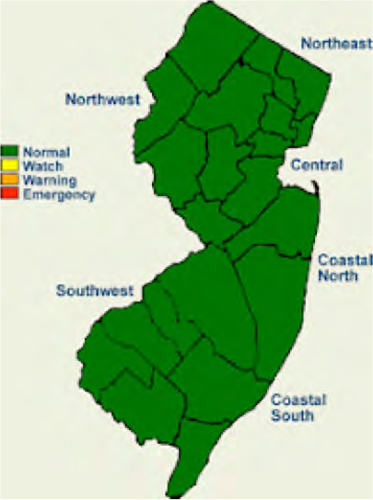
TARGET MARKET
The $60 Billion Hemp Industry is Growing

Slide 11
Weedmaps vs. Leafly: Who focus on products and dispensary assocated revenues
Take Hemp focused on the SMB that always needs new customers
CBD Products-5 Billion in 2020
By 2025 CBD products sales can be 17 Billion
in USA
By 2027 CBD will account for more than
20% of the global dietary and supplement
market
According to a Gallup poll, support for legal marijuana is at an all- time high of 68%.
Among 18 to 29-year- olds, that support rises to 79%.

Slide 12
Competition
Yelp
Nautal Awakenings Magazine
YELP
10 Static CBD online directories
Weed Maps
Natural Awakenings Mag
LEAFLY
Leafly
Weedmaps
TAKE HEMP

Slide 13
Competitive Advantages
Hyper Local Search
New Jersey Small Businesses rely on local search.
Affilate Sales Team
Commissioned based sales team
Less G&A Expenses Profitalbe Outsource
New Jersey SMB Focus
Affordable pricing and incentives with dedicated 24/7 Support
Growing Extended Distribution Network

Slide 14
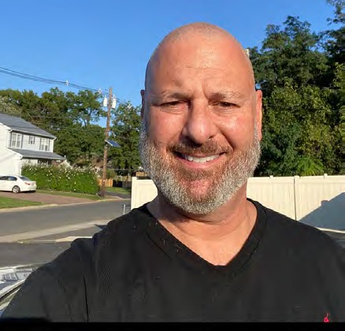
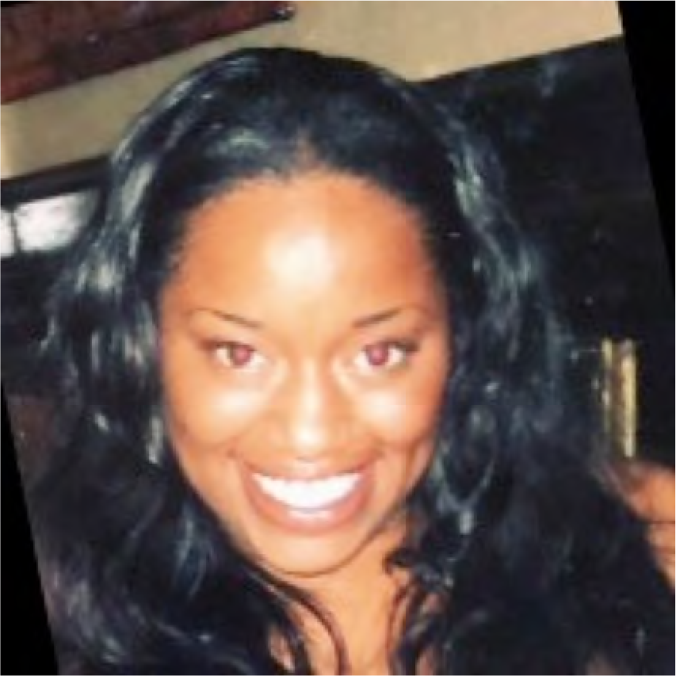
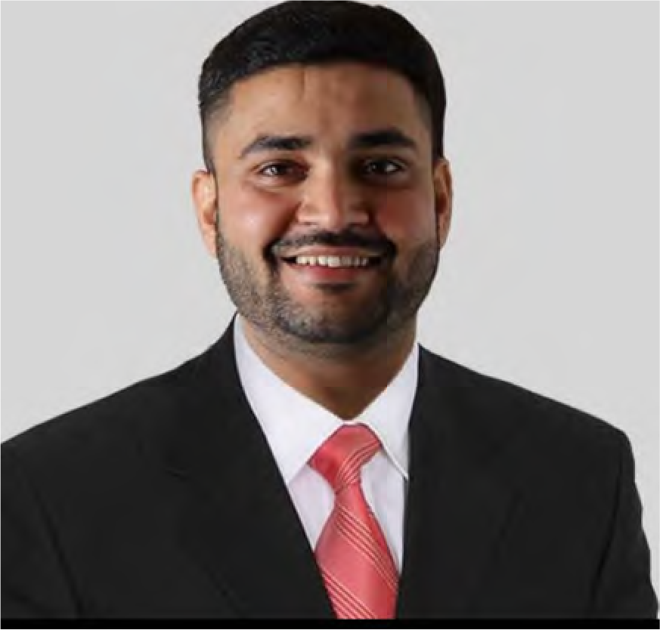
Team
We’ve Been Here Before. SMB Leaders. Closers. Online Directories & Review Site Experts, Inside and Out.
Core Team Members From The Following Companies
Indyana Davis
Chief Diversity Officer
Eric Mann
Consultant- Network Admin & Sales Ops Support
Vimal Panday
Web Development
Marc “Jake” Jacobson
Founder & CEO

Slide 15
Take Hemp, Inc Marc Jacobson
847 Westfield Avenue
Rahway, NJ 07065 Marc@TakeHemp.com Text/Call- (844)482-5343 http://www.takehemp.com/
OCTOBER 06,2021

